Slide 1
2022 Annual General Meeting
VolunteerConnector
(Volunteer Centre of Calgary)

Slide 2
Land Acknowledgement
https://www.volunteerconnector.org/who-we-are
We acknowledge that Indigenous peoples are the traditional guardians of this land that we call Canada
We believe that acknowledging the land we are fortunate to live and work on, and the people who came before us, is an important step toward reconciliation. We encourage everyone to educate themselves on land acknowledgments, Canada’s history with Indigenous peoples and the 94 calls to action in the Truth & Reconciliation Commission’s Report. We remain committed to our ongoing anti-racism and decolonizing journey personally and in volunteerism.

Slide 3
Why People Volunteer?
Wanting to be connected to a larger cause and make an IMPACT
To meet people and create new CONNECTIONS
To find a new or renewed sense of BELONGING
**Anti-Racist Approach to Volunteering: Jan ‘22
Notes:
Top 3 reasons for volunteering as reported by volunteers:
Volunteers continued to pour into the VolunteerConnector looking for new opportunities to connect with their neighbours.
Volunteers continue to relate strongly to grassroots initiatives

Slide 4
Data Telling a Story
18.114%
22.852%
Volunteers seeking to volunteer
Organizers calling for volunteers
**2022: Volunteers – 2,652,910 : Organizations – 4,853

Slide 5
Volunteer Demographics – Gen Z
Pre Pandemic (17.7%)
Post Pandemic (26.6%)
**Volunteers: Jan - Feb 2020 – 50,086 : Jan - Feb 2023 – 86,406

Slide 6
Volunteer Preferences
**Volunteers: Jan 2020 – 21,727 : Apr 2020 – 93,522 : Apr 2023 – 40,680

Slide 7
Volunteer Compassion
Refugees & Settlement
Social Justice:
Anti Racism – BLM, Residential Schools
Environment – BC Wildfires
**Volunteers: Jan 2022 – 39,355 : May 2022 – 39,928 : Apr 2023 – 40,680

Slide 8
The Rest of 2023 & Beyond . . .
Connect with coaching opportunities via Eventbrite Sessions hosted by Sheena
Connect with the us via info@volunteerconnector.org hosted by Tracy
Connect with the data we presented today via your organization’s dashboard / our blog
Upgrade your subscription to get first access to new features launching every 6 months
Connect with one another and your community via the VolunteerConnector
Notes:
Top 3 reasons for volunteering as reported by volunteers:
Volunteers continued to pour into the VolunteerConnector looking for new opportunities to connect with their neighbours.
Volunteers continue to relate strongly to grassroots initiatives

Slide 9
Why Adapt Your Engagement?
Wanting to be connected to a larger cause and make an IMPACT
To meet people and create new CONNECTIONS
To find a new or renewed sense of BELONGING
Notes:
Top 3 reasons for volunteering as reported by volunteers:
Volunteers continued to pour into the VolunteerConnector looking for new opportunities to connect with their neighbours.
Volunteers continue to relate strongly to grassroots initiatives

Slide 10
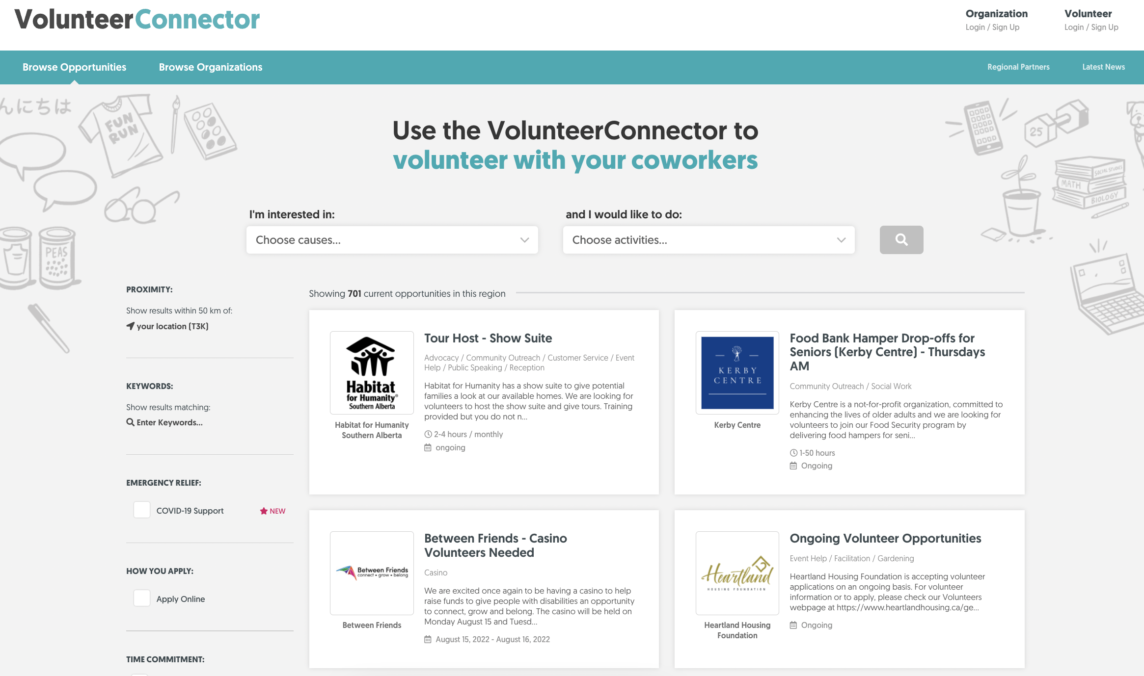
That’s a wrap . . . www.volunteerconnector.org

